Slide 1
The Team Meeting
Dirk Riehle, Univ. Erlangen
AMOS A04
Licensed under CC BY 4.0 International

Slide 2
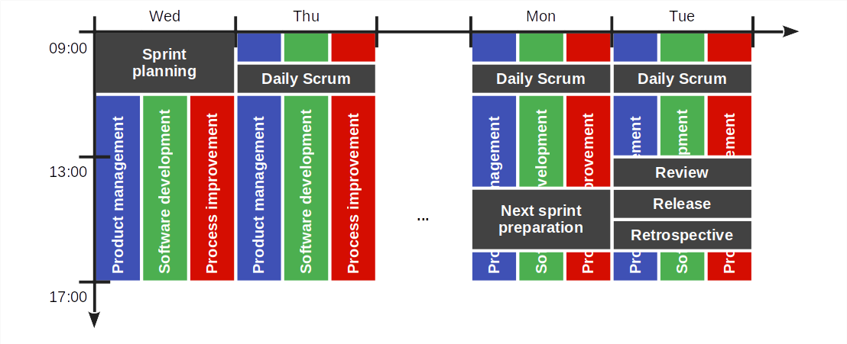
The AMOS Scrum Sprint

Slide 3
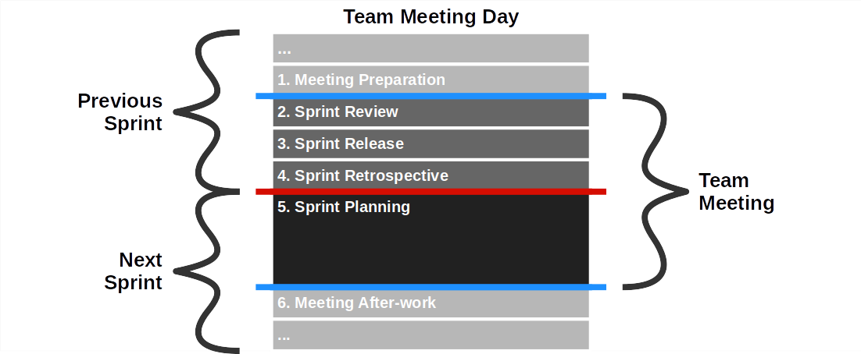
The AMOS Team Meeting

Slide 4
1. Meeting Preparation
Release manager
Ensure that a working demo system will be available
Tag release candidate with sprint-xx-release-candidate
where xx is your sprint number (see project schedule)
Product owner
Ensure that product backlog is ready for sprint planning
Include new feature requests
May include bugs as issues
May include refactorings
This should be done in a next sprint preparation meeting

Slide 5
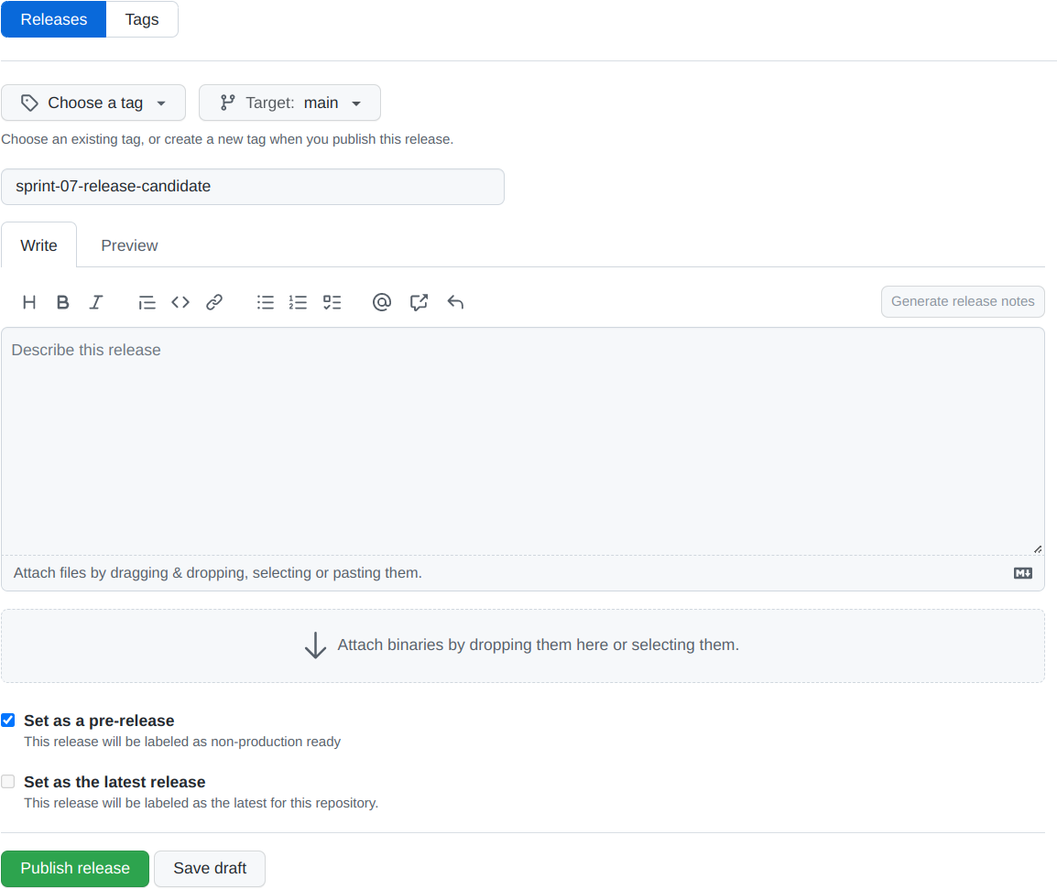
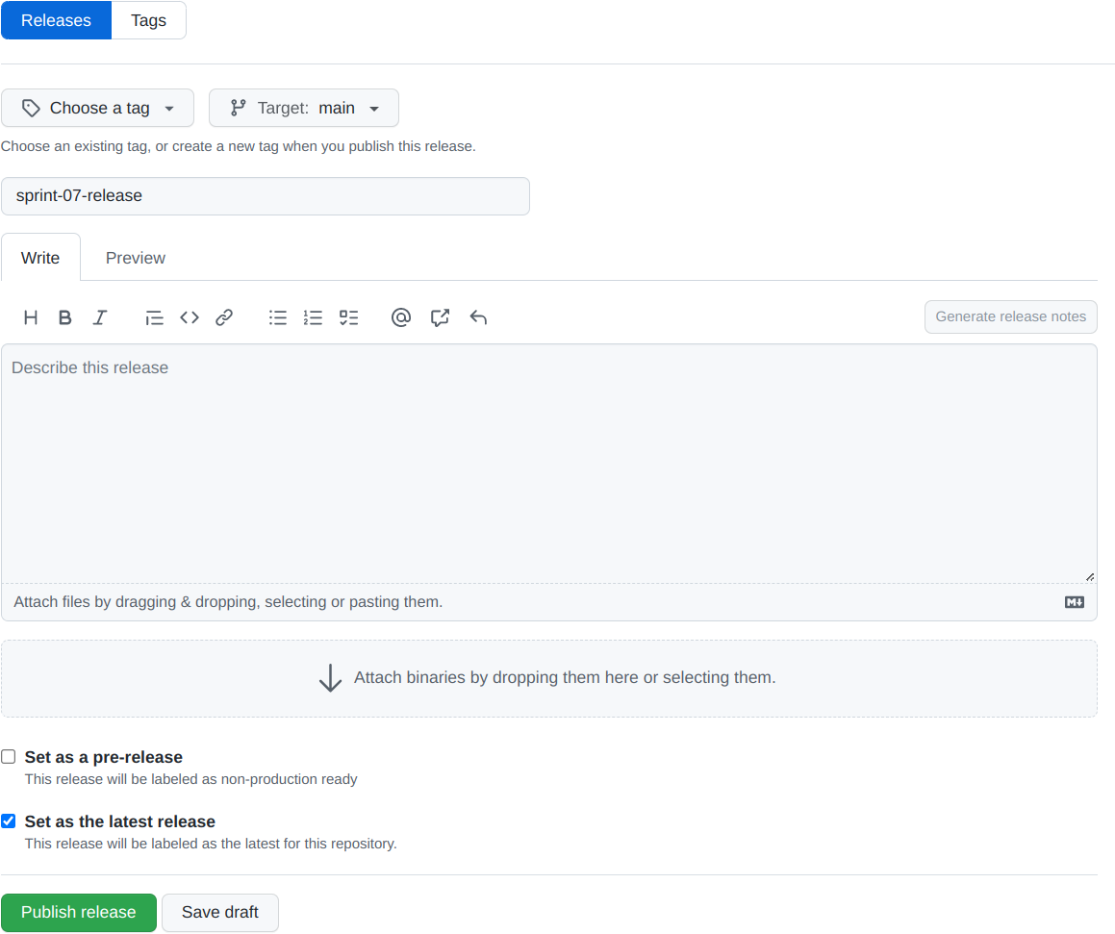
Tagging Release Candidates and Releases
Release candidate
Release [1]
[1] Do not rename release candidate

Slide 6
2a. Sprint Review
Release manager
Check-out fresh code base using release candidate tag
Compile, build, and run tests for release candidate
Deploy release candidate to test environment
The release manager does not run the review

Slide 7
2b. Sprint Review
Product owner
Walk through “Awaiting review” column item by item
Ask developer to demo item under review
Check fulfillment of acceptance criteria
Check fulfillment of definition of done, if required
Check other criteria incl. logging output for problems
If successfully implemented, move item to feature archive
Ask developers about real size, add it to the item
If not successfully implemented, move item back to product backlog
Software developer
Demo backlog item as requested by product owner
Answer questions about item design and implementation
Provide real size as determined after implementation

Slide 8
3. Sprint Release
Product owner
Decide whether release candidate should be released
Only in case of significant regression should you not release
Later in the course you will use a definition of done
Specifics depend on type of release
Consult with software developers if necessary
Release manager
If the release candidate is to be released
Deploy sprint release to operations environment
Tag release with sprint-xx-release where xx is your sprint number
If you maintain a change log (optional)
Update change log with release information

Slide 9
4. Sprint Retrospective
Scrum Master
Review this sprint’s impediments
Report on progress
Review remaining problems
Surface new impediments through roll call
What has gone well?
What hasn’t gone well?
What can we do better?
Put new impediments into impediments backlog
Everyone
Answer to happiness index

Slide 10
5. Sprint Planning
Product owner
Reprioritize product backlog items, if necessary, on-the-fly
Work through top-prioritized backlog items one-by-one until finished
For each product backlog item, explain it, ask developers to estimate and commit
You are finished, if the team does not want to take on more backlog items
Software developer
Estimate size of each backlog item using planning poker
After planning, commit to backlog items in sprint backlog
Everyone
Make sure roles for sprint are clear to everyone

Slide 11
Story Points
Story points
Is an arbitrary numeric measure of size of a given backlog item
Properties
Is a measure of size, not of effort or duration
Measured in non-linear increments, forcing choice
Is socially agreed upon, depends on team estimation history
Is independent of a particular person (and their skills)
Is mapped to time using the team's velocity (development speed)
Points | Meaning
0 | No size
1 | Trivial size
2 | Small size
3 | Medium size
5 | Large size
8 | Very large size
13 | Too large (size)

Slide 12
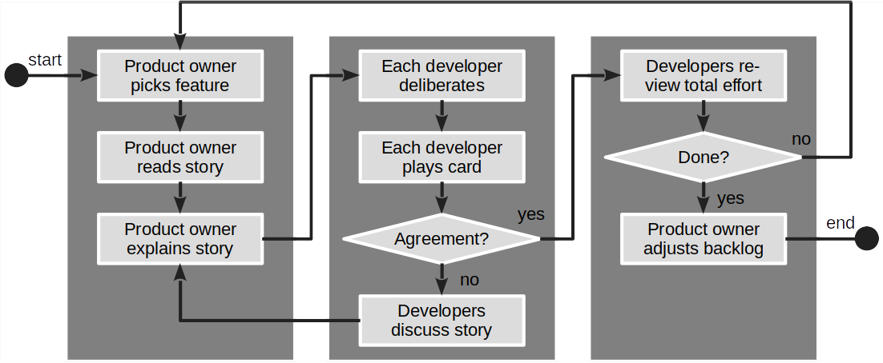
Flow Diagram for Sprint Planning [1]
[1] A simple planning poker cards replacement can be found in the planning documents

Slide 13
6. Meeting After-work
Product owner
Update planning documents to consistent state
Clean up product and sprint backlog
Ensure feature archive is current
Software developer
Plan programming tasks (1 feature = 1+ tasks)
Agree on which developer(s) work(s) on which tasks
If pair programming, ensure you document the pair
Scrum Master
Work on resolving impediments during sprint
Document resolutions in impediments backlog

Slide 14
An Efficient Team Meeting Takes 90 Min.
# | Section | Duration
1 | Meeting preparation | -
2 | Sprint review | ~35%
3 | Sprint release | ~5%
4 | Sprint retrospective | ~20%
5 | Sprint planning | ~40%
6 | Meeting after-work | -

Slide 15
Thank you! Any questions?
dirk.riehle@fau.de – https://oss.cs.fau.de
dirk@riehle.org – https://dirkriehle.com – @dirkriehle

Slide 16
Legal Notices
License
Licensed under the CC BY 4.0 International license
Copyright
© Copyright 2023 Dirk Riehle, some rights reserved

